Slide 1


Auto Cart
Proposed by : Team Vibhav

Slide 2


Have you ever thought what if you could go to a supermarket grab your things and just walk out of the shop?
About the
Project
With the aim to make shopping hassle free and more automated, we present to you our project: Auto Cart.
In this project we have just transformed a normal cart to an automated billing cart.
In the cart, just add your things and and can see your bill in the app and pay it just from your phone.

Slide 3
Problem The Project Solves
Shopping is easy but waiting on a bill counter after shopping is too boring and tedious.
Also in this Covid era, one has to restrain from going into crowded places. In the malls, the area which is the most crowded is near the bill counter only.
Our project aims to help everyone with the problem of long queues in front of the bill counter, everytime a person visits a mall or a supermarket.

Slide 4
Solution To The Problem
To solve the previously mentioned problem, we came up with the idea of Auto Cart.
The whole system will be integrated in the shopping trolley itself and the shopping bill can be automatically generated by the customers.
A customer has to firstly connect the trolley with the app. Then, any item placed in the cart by the customer would be automatically detected by the system.
Total is automatically calculated in the app, and then the user can pay the amount using UPI or credit/debit cards through the payment gateway in the app..
Hence, this system ensures hassle free shopping for all the customers visiting the mall.

Slide 5
Techstack Involved
The main technology used in this project is RFID.
Our project consists of two parts: Hardware part and the app.
The hardware consists of an RFID reader connected to NodeMCU, which in turn is connected to the app through cloud.
All the products have RFID tags on them. The reader detects the Unique ID of the tag on the product, when customer places it in the cart and sends it to NodeMCU. NodeMCU send the UID to the app connected to the cart through cloud.
Coming to the app part, the app is built in Flutter, and has RazorPay payment gateway integrated through which the user pays the total shopping amount

Slide 6
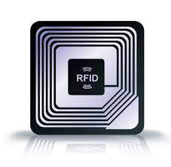
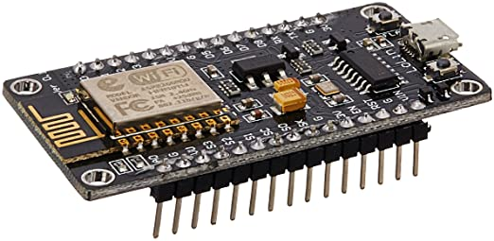

RFID Technology: RFID is an acronym for “radio-frequency identification” and refers to a technology whereby digital data encoded in RFID tags or smart labels (defined below) are captured by a reader via radio waves.
NodeMCU: NodeMCU is an open-source Lua based firmware and development board specially targeted for IoT based Applications. It includes firmware that runs on the ESP8266 Wi-Fi SoC from Espressif Systems, and hardware which is based on the ESP-12 module.
Flutter: Flutter is a free and open-source mobile UI framework created by Google. Through Flutter, we can create a native mobile application with only one codebase. This means that you can use one programming language and one codebase to create two different apps (for iOS and Android).

Slide 7
Novelty of the Solution
The solution that we propose has yet not been implemented anywhere here in India, however similar solutions do exist in other countries such as Japan.
RFID technology is already implemented in most of the malls currently for theft checking.
Our aim is to modify the currently existing system, by integrating our product with it, so that auto billing system can be implemented.
Hence, our approach to the problem is novel.

Slide 8
Social Applications
The system that we propose eliminates the long queues in front of the bill counters in the malls, and by doing so:
It will ensure hassle - free shopping for all the customers visiting the mall, thus saving time of the customers.
It will help in maintaining social distancing in this pandemic as customers do not have to stand in long queues for paying the bill.

Slide 9
Business Aspects
Overall cost of the proposed system that is to integrated with every cart is around 800 Rs. ( NodeMCU - 350 Rs.,, RFID Reader - 400 Rs).
Cost of the RFID tags that is to be applied on every product is around 3-4 Rs.
Targeted malls are fashion and clothing malls like FBB and Pantaloons as the minimum cost of the products is 100 Rs. Hence, applying tags to all the products is also cost efficient.
Hence, the system proposed by us can be efficiently integrated into the malls.

Slide 10
Thank You!

